Slide 1
House Price Analysis and Prediction Using Machine Learning
Vuyo Matomela
Witle Academy
Instructor: Taryn Michael

Slide 2
Introduction
House prices are influenced by many factors such as location, house size, quality, and garage capacity.
Traditional valuation methods can be subjective, so machine learning provides a data-driven approach to estimate house prices more consistently.

Slide 3
Problem Statement
Goal: Build a model capable of predicting house prices using historical housing data.
Predicting house prices manually is difficult because many variables influence the final selling price.

Slide 4
Objectives
Explore
Explore the dataset
Clean
Clean the data
Perform
Perform exploratory data analysis
Build
Build prediction models
Compare
Compare model performance
Identify
Identify important features

Slide 5
Dataset
Dataset
Ames Housing Dataset - Kaggle
Include:
Number of rows
Number of columns
Target variable (SalePrice)

Slide 6
Data Cleaning
Missing values
Duplicate removal
Handling outliers
Encoding categorical variables

Slide 7
Exploratory Data Analysis
Distribution of SalePrice
Correlation heatmap
Scatter plot (GrLivArea vs SalePrice)

Slide 8
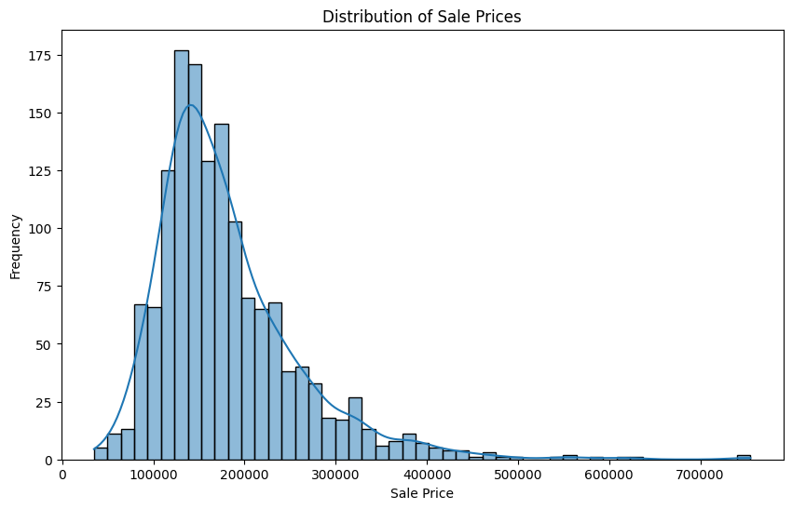
Distribution of SalePrice

Slide 9
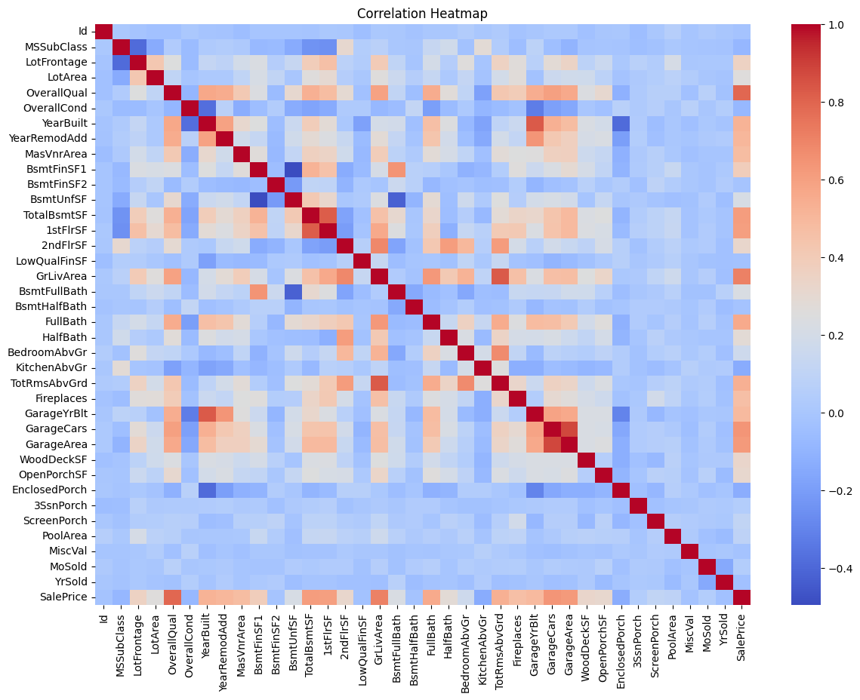
Correlation heatmap

Slide 10
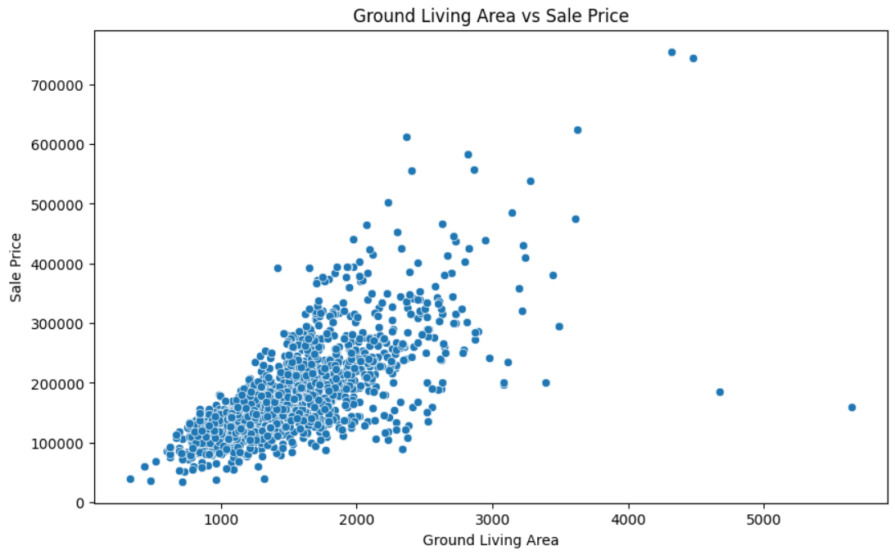
Scatter plot (GrLivArea vs SalePrice)

Slide 11
Machine Learning Models
Linear Regression
Decision Tree Regressor
Random Forest Regressor

Slide 12
Results
Model | MAE | RSME | R^2
Random Forest | 17672.18 | 28848.29 | 0.89
Decision Tree | 26986.47 | 41518.96 | 0.78
Linear Regression | 20498.51 | 49289.19 | 0.68

Slide 13
Results
Among the three models evaluated, the Random Forest Regressor achieved the best performance.
It produced the highest R² score and the lowest prediction errors (MAE and RMSE), making it the most accurate and reliable model for predicting house prices in this project.

Slide 14
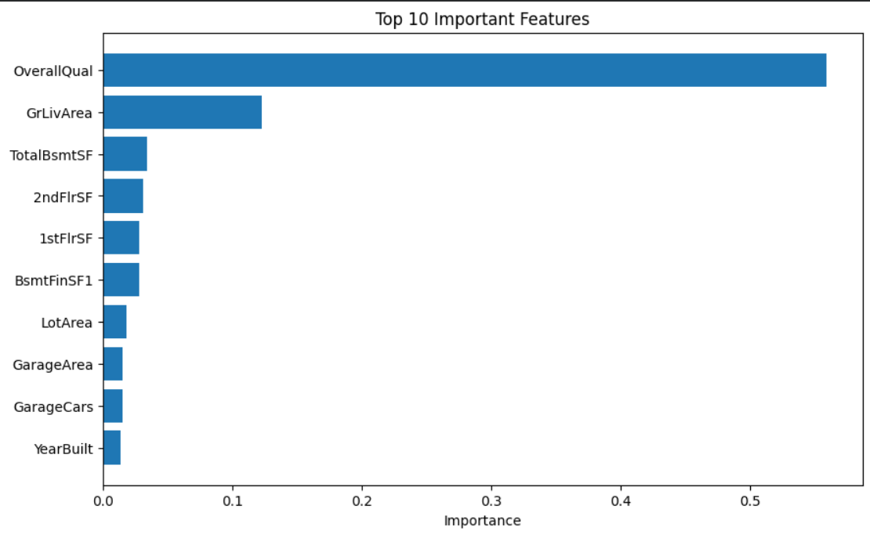
Feature Importance

Slide 15
Conclusion
This project demonstrated how machine learning can be used to predict house prices through data preprocessing, analysis, and model evaluation. The results highlight the value of data-driven approaches in building accurate predictive models.

Slide 16
Thank You

